Slide 1
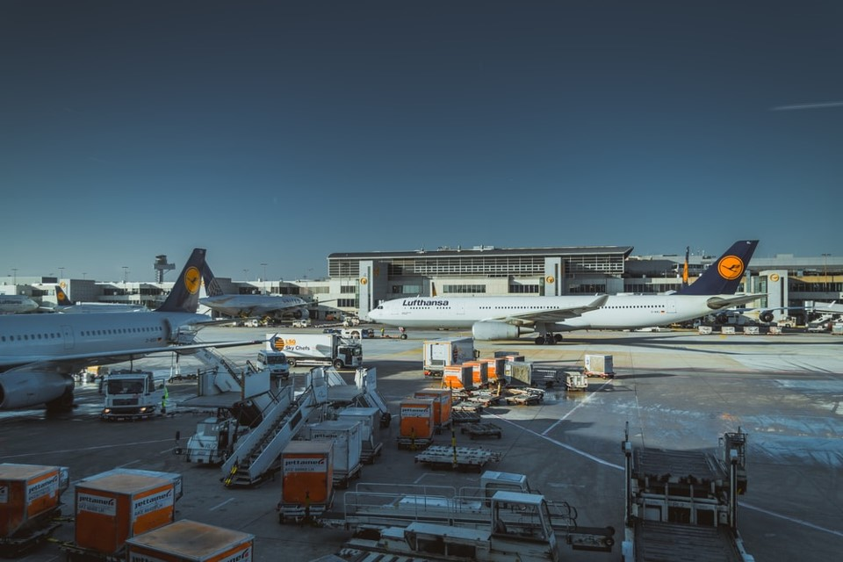

UNDERSTANDING AIRLINES’ CUSTOMERS SATISFACTION
BAN140NBB
Project Milestone 3
By Group 3

Slide 2
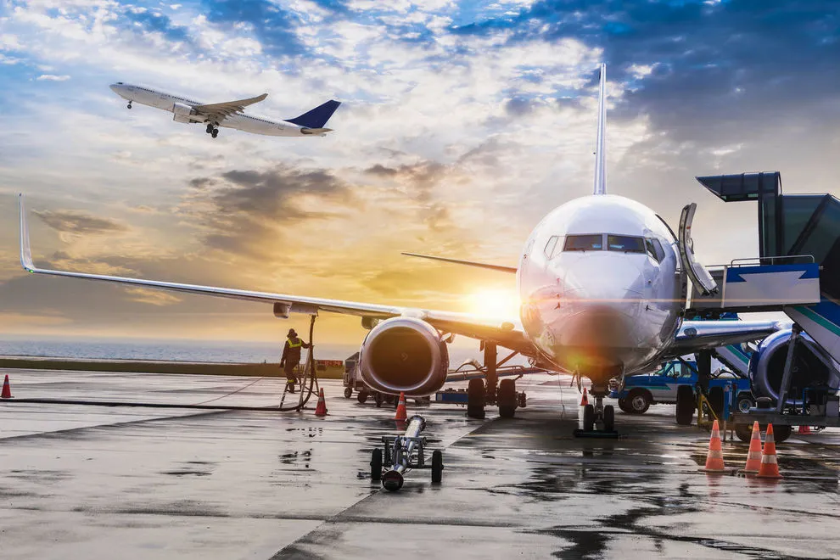
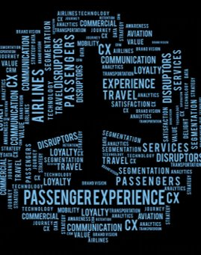
Dataset
Customer Satisfaction scores of 120k + airline passengers based on the evaluation of multiple factors
Source: John D, via Kaggle
Target audience: Stakeholders of the airlines

Slide 3
AGENDA
AIRLINES CUSTOMER’S BACKGROUND
AIRLINES CUSTOMERS’ SATISFACTION PAIN POINTS
AREAS FOR AIRLINES IMPROVEMENTS

Slide 4
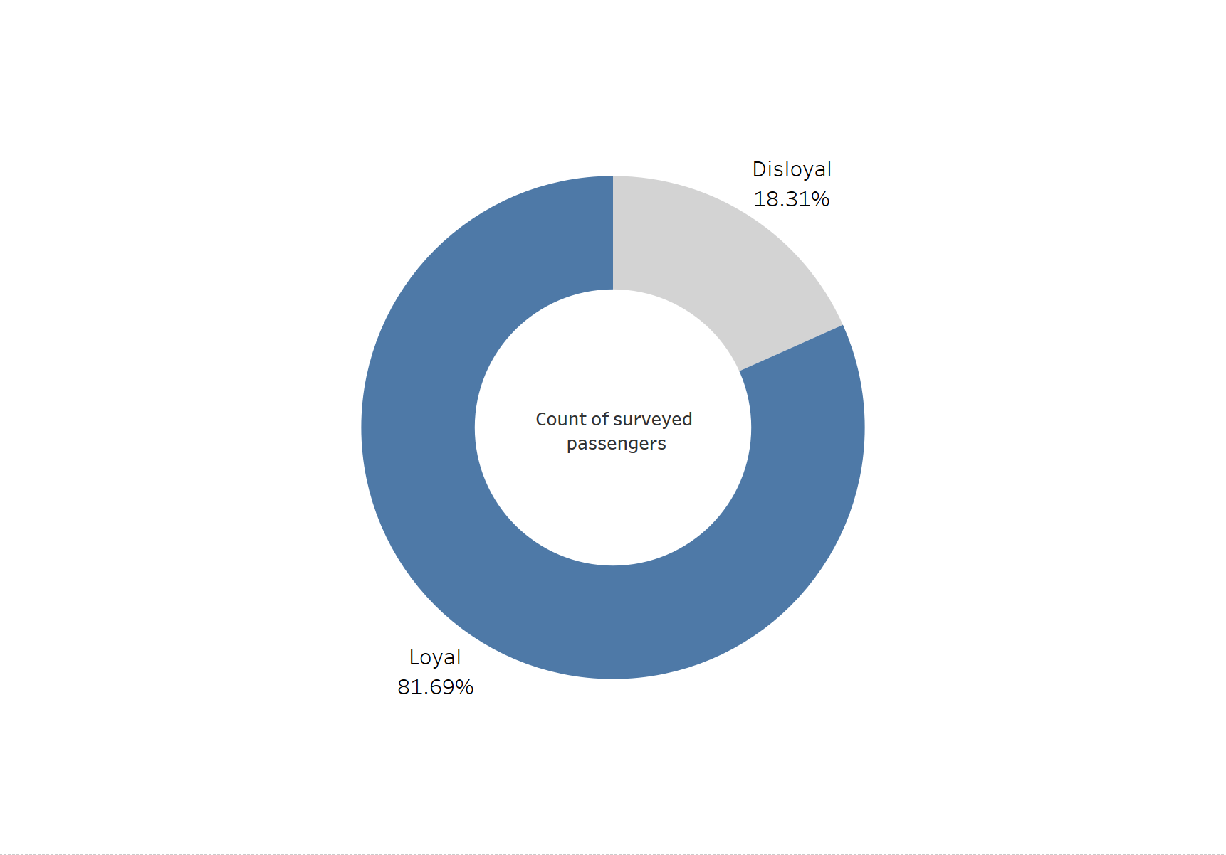
Loyal customers are important to Airlines
Survey shows that more than 80% of Airlines customers are loyal ones who returned multiple times

Slide 5
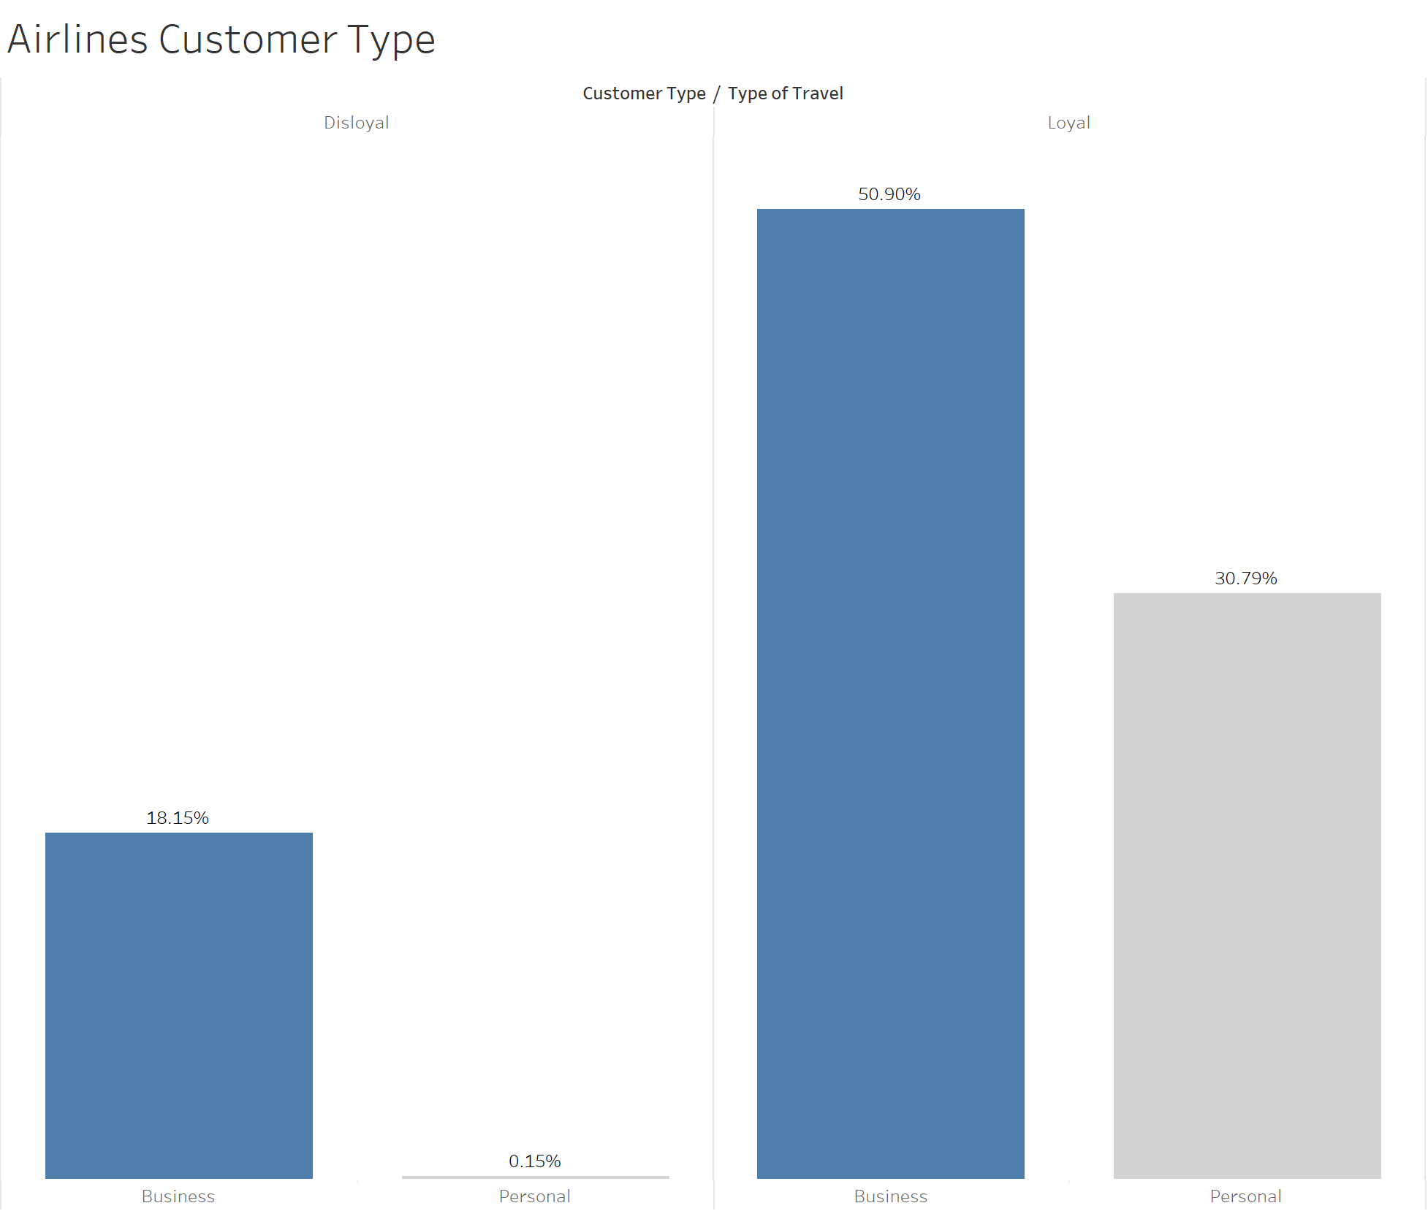
Most Airlines passengers are multiple goers with Business purposes
Survey shows that Business Passengers who returned 2.5 times higher than those who traveled first time
Personal Passengers are mostly returning ones; yet still less than Business class people

Slide 6
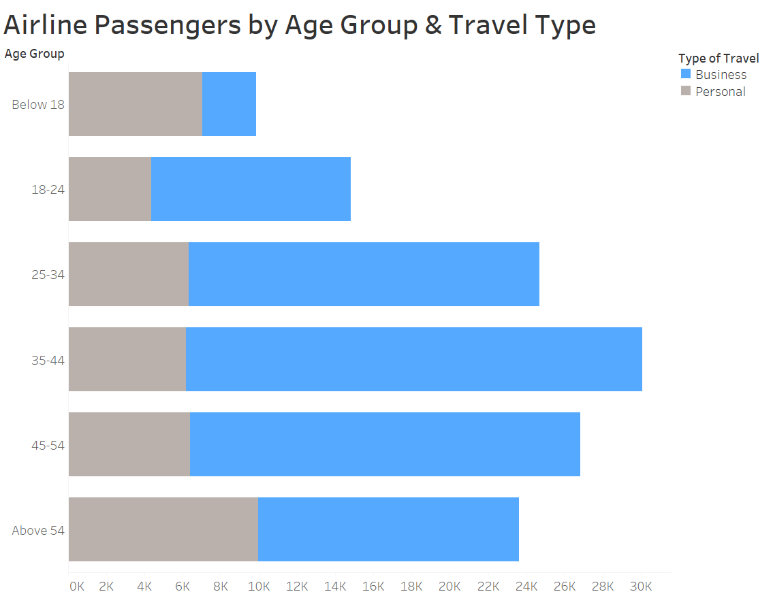
The older group (25+) travels more than the younger group (under 25)
Survey shows that 35-44 y/o passengers are top travelers; followed by 45-54 y/o, 25-34 y/o & 54+; which makes 25+ the majority profile of airline passengers.
Passengers under 25 y/o are much less than the 25+ Personal Passengers

Slide 7
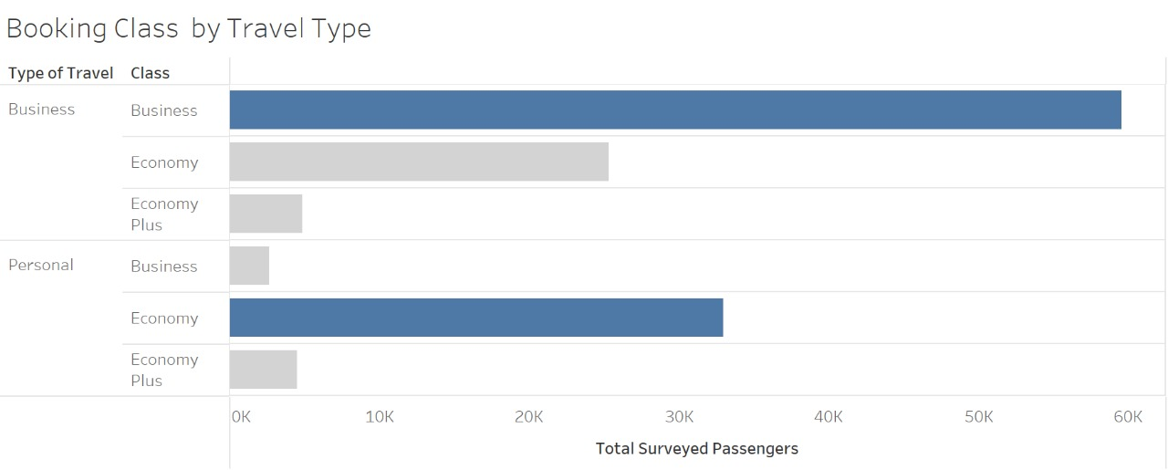
Business class is mostly used for work trips while Economy class is for personal trips
Survey shows that Business class is the most chosen booking class for people who go on Business trips; followed by Economy option.
For Personal trips, Economy is the most preferred class for its cost-friendly reason

Slide 8
AGENDA
AIRLINES CUSTOMER’S BACKGROUND
AIRLINES CUSTOMERS’ SATISFACTION PAIN POINTS
AREAS FOR AIRLINES IMPROVEMENTS

Slide 9
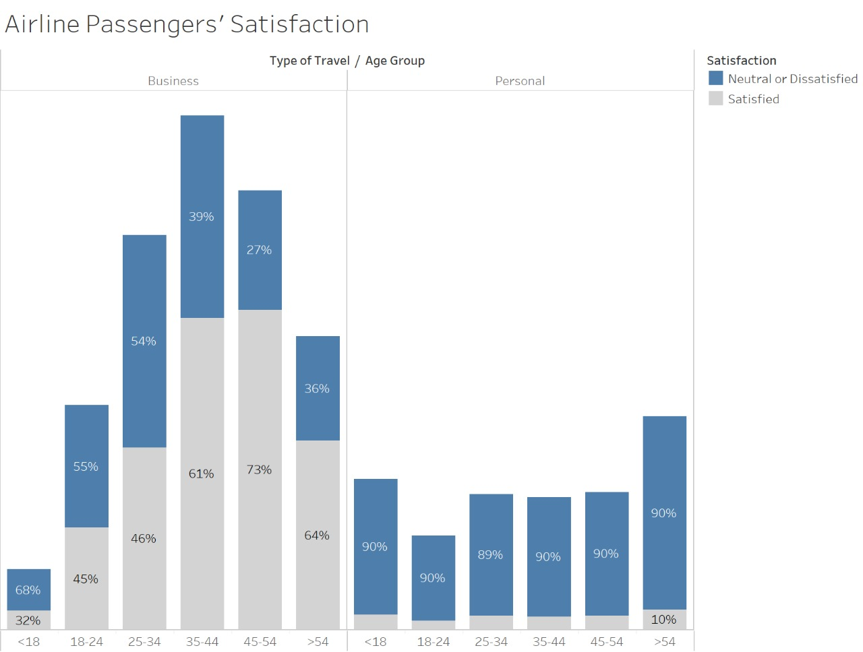
Majority of Personal Passengers are unhappy
Survey shows that a high level of Personal Passengers responded to be unsatisfied across all age groups;
For Business Passengers, they are quite satisfied except for the minor group of below 18

Slide 10
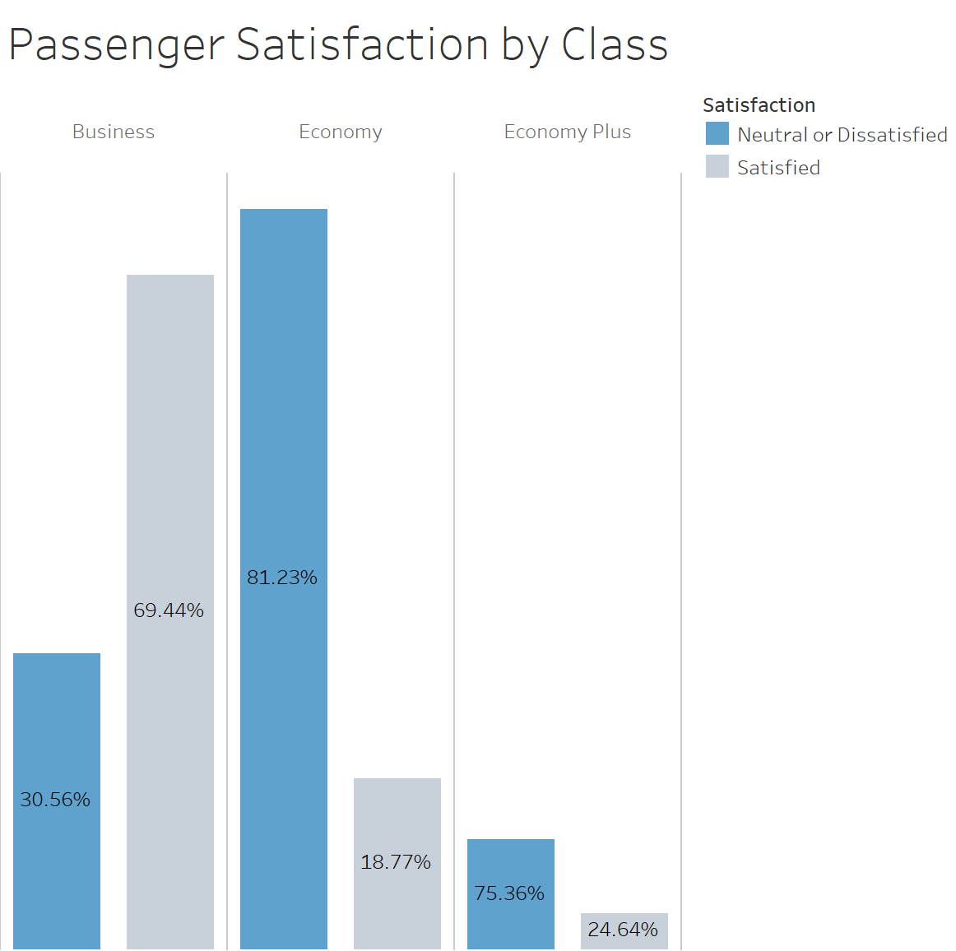
Majority of Economy-class Passengers are unhappy as well
Survey shows that a high level of Economy Passengers responded to be unsatisfied
In contrast, Passengers in Business class are quite satisfied at almost 70%, doubled Dissatisfied level

Slide 11
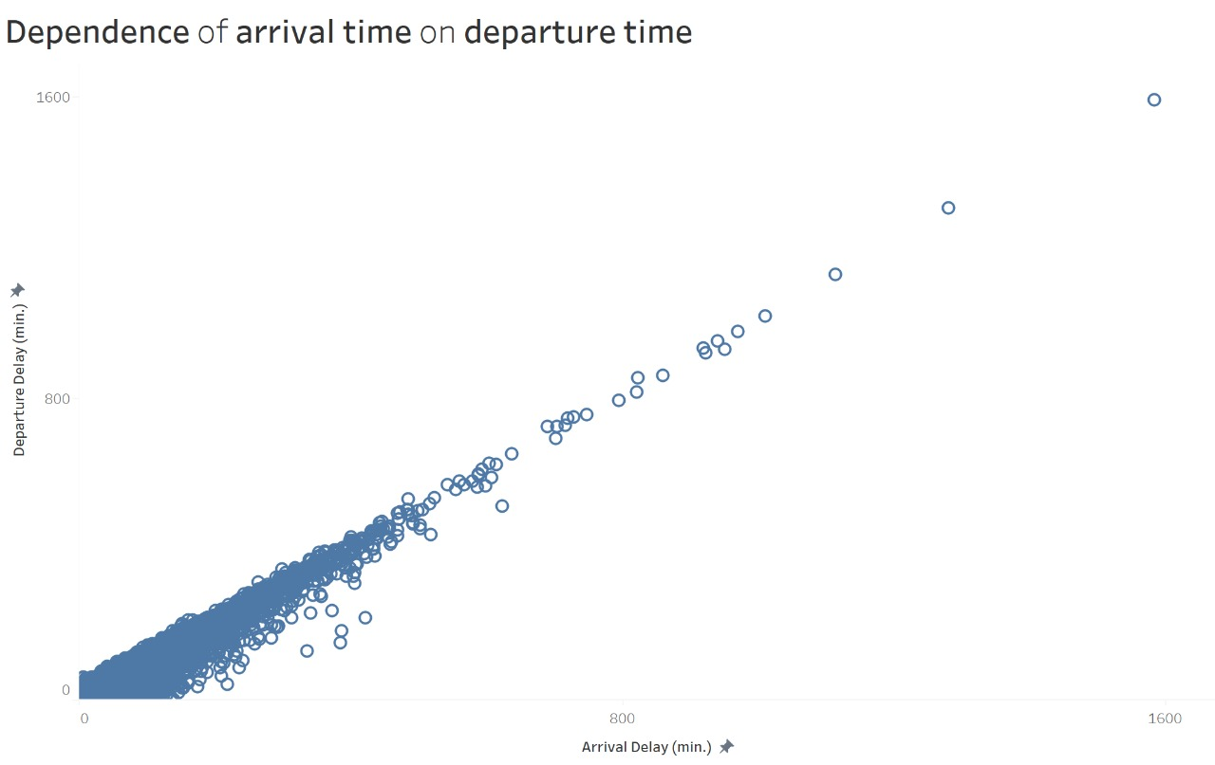
Delay is a major concern in both Departure & Arrival time
Survey shows that there is a strong correlation between Departure delay time & Arrival delay time. The more it gets to depart, the longer it takes to arrive. Thus it could affect consumers’ schedules a lot.

Slide 12
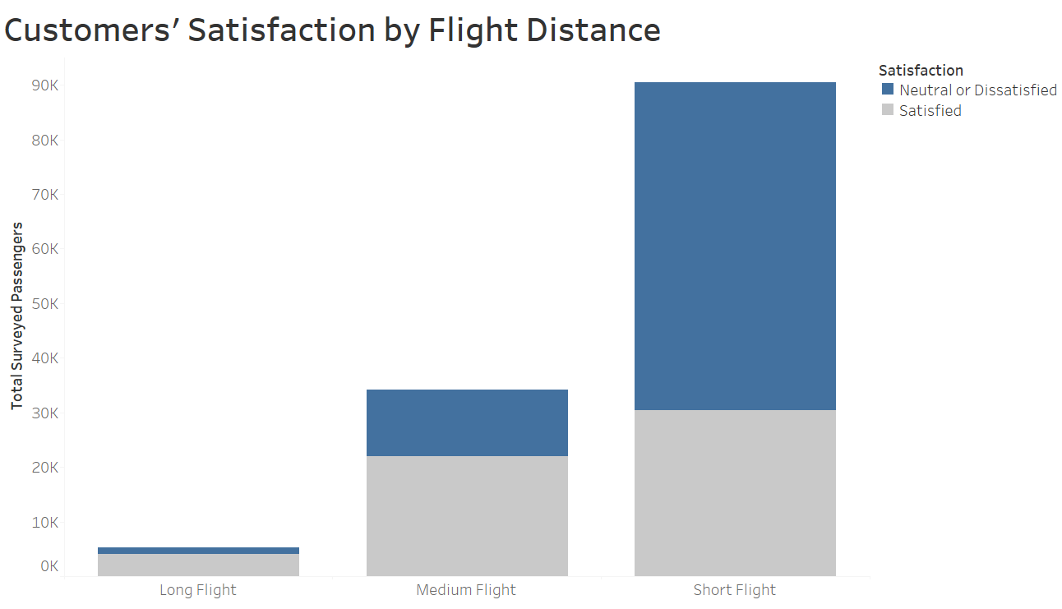
Short-trip passengers tend to be more unhappy than others going in longer flight
Survey shows that Short-flight passengers who are dissatisfied are doubled than those who satisfied.
In contrast, Medium & long-flight goers are more satisfied with their trips

Slide 13
AGENDA
AIRLINES CUSTOMER’S BACKGROUND
AIRLINES CUSTOMERS’ SATISFACTION PAIN POINTS
AREAS FOR AIRLINES IMPROVEMENTS

Slide 14

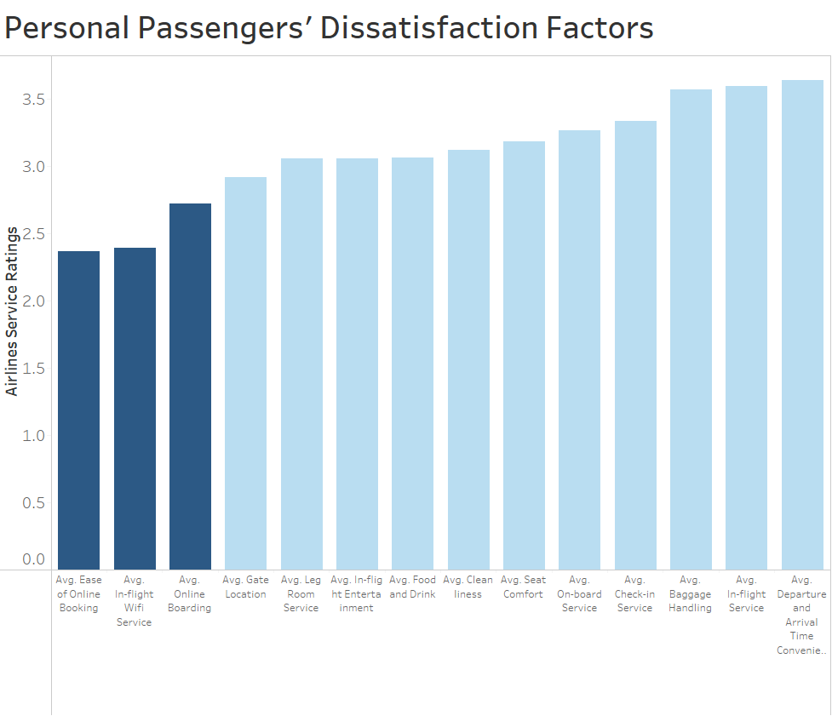
Online experience (Booking, In-flight Wifi, Boarding) is the most urgent area for improvement for casual trips

Slide 15

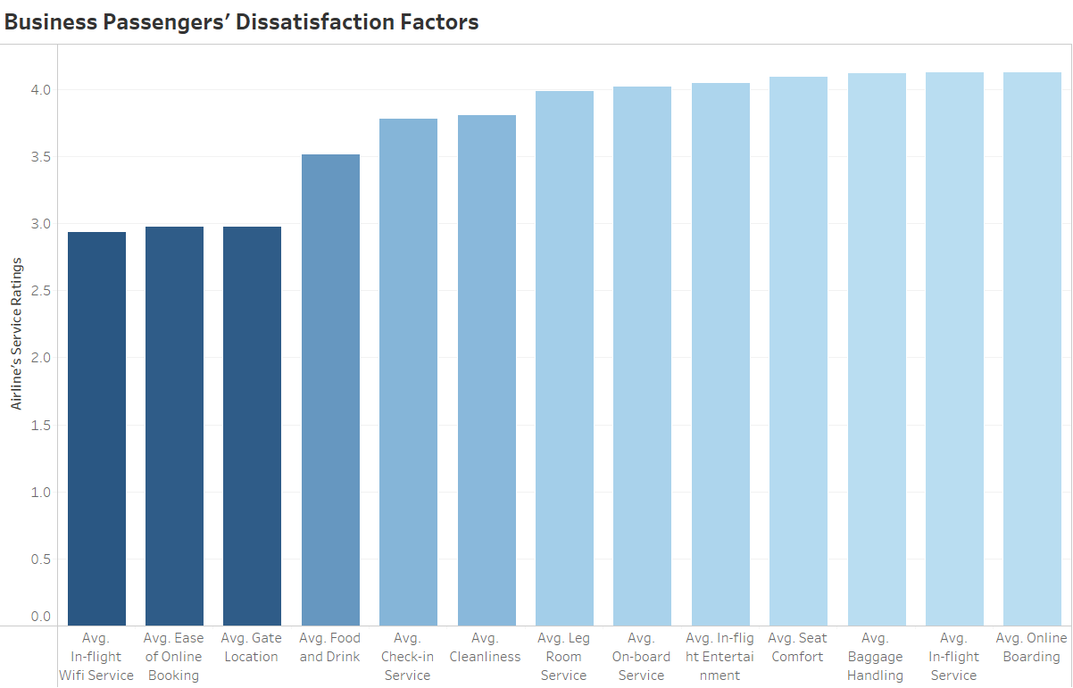
Business experience needs to be stress-free and simple

Slide 16
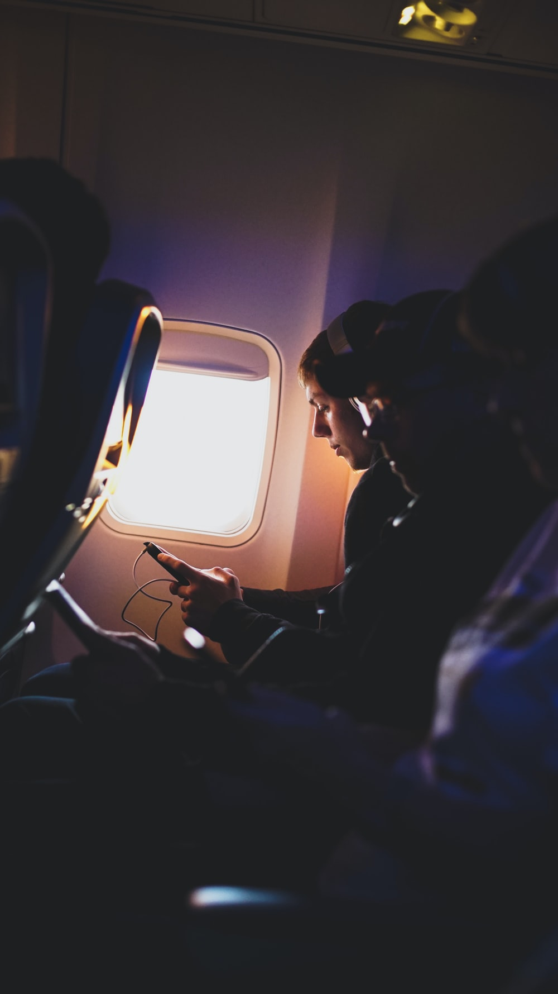
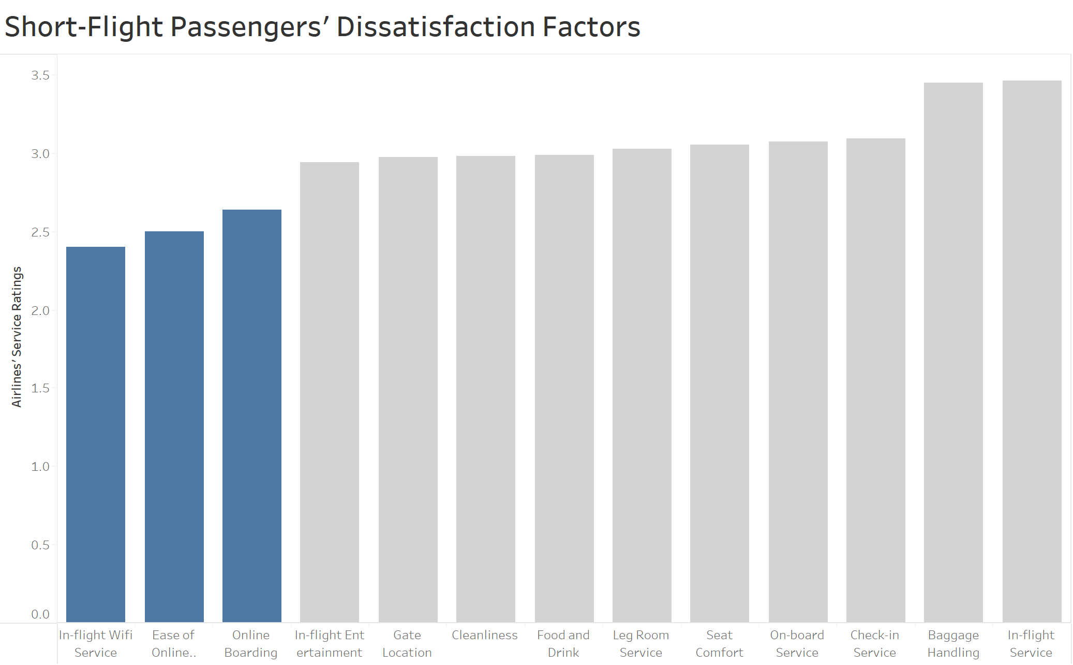
Short trips needs to be more online convenient

Slide 17
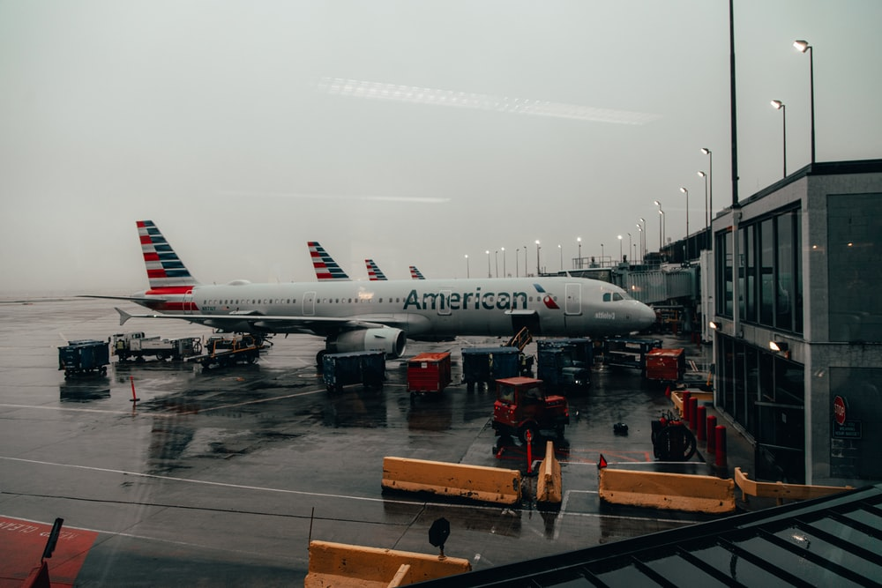
THANK YOU

